Slide 1
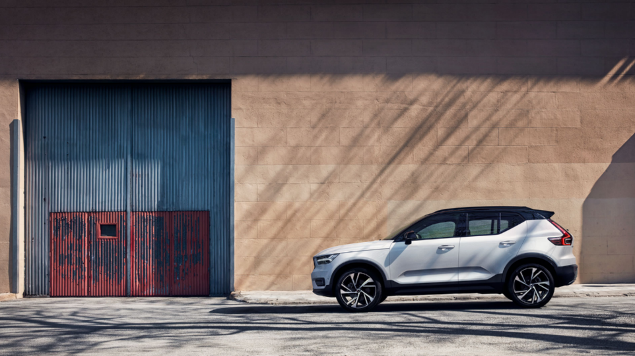
Zhu Xiaofeng’s sharing

Slide 2
Self-introduction
Name: 朱晓峰 zhu xiaofeng
Birth: the year 1988
University: Shanghai University Of Engineering Science
Address: Minhang District
Native place: Shanghai

Slide 3




Interest

Slide 4
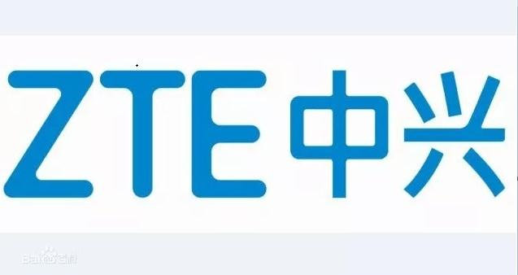
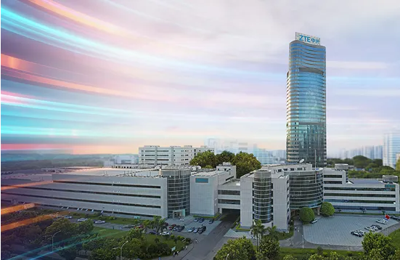
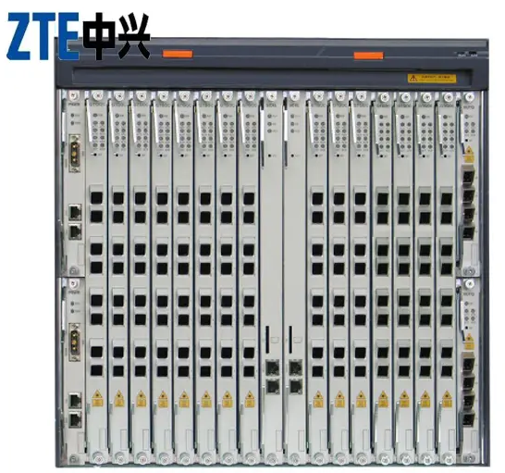
work experience
ZTE Corp., China's largest listed telecommunications equipment company.
Main products include: 2 g / 3 g / 4 g / 5 g wireless base station and core
network, IMS, fixed network access and hosting, chip, optical network,
high-end routers, intelligent switches, enterprise network, big data, cloud
computing, data center, mobile phone and domestic terminal, wisdom,
ICT business city, as well as aviation, railway and urban rail transit signal
transmission equipment.

Slide 5
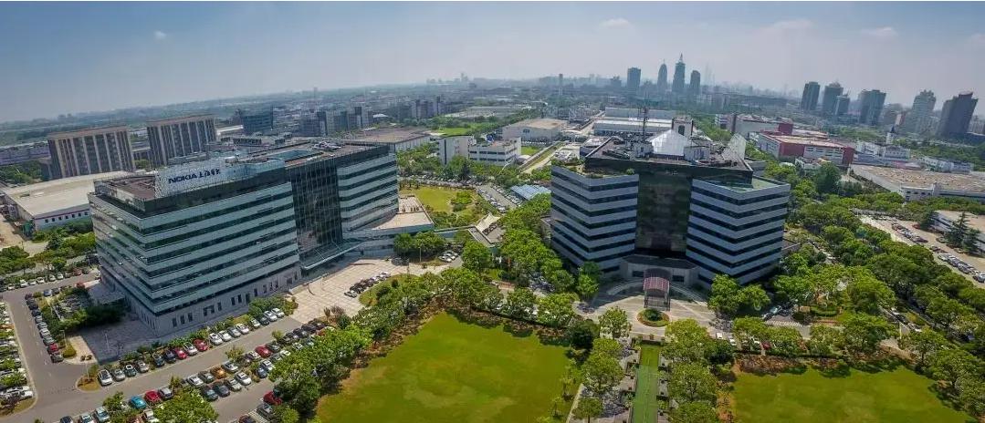
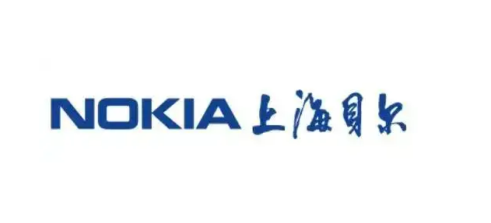
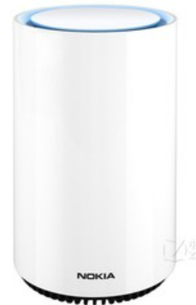
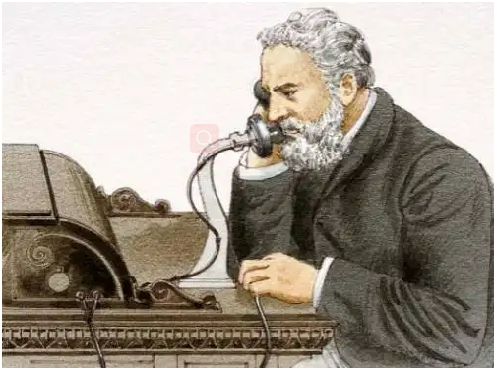
work experience
Founded in 1984, Shanghai Bell Co., Ltd. is a directly subordinate
enterprise of State-owned Assets Supervision and Administration
Commission of the State Council, and is the first joint-stock company
with foreign investment in China's high-tech field
Bell invented the telephone in 1876
Bell LABS has won more than 25,000 patents and eight (13) Nobel Prizes in total

Slide 6
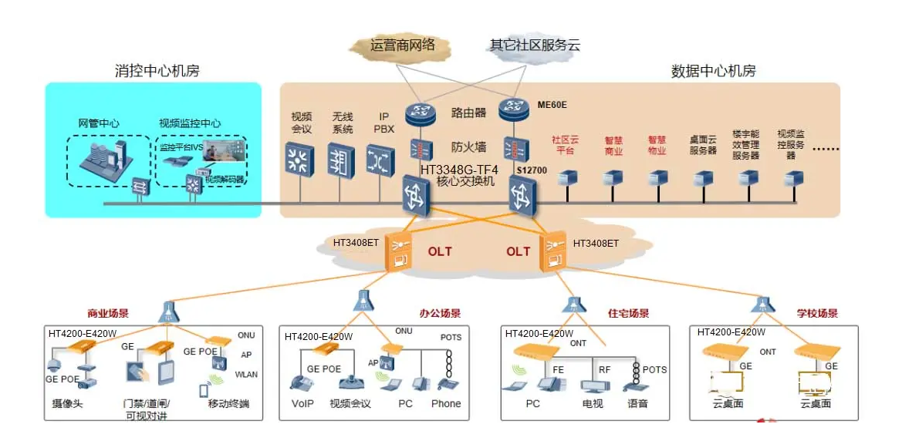
Topo-Ethernet

Slide 7
AT introduction (ZTE Nokia-Bell)
Base on Linux
Python
Robotframework
Jenkins

Slide 8
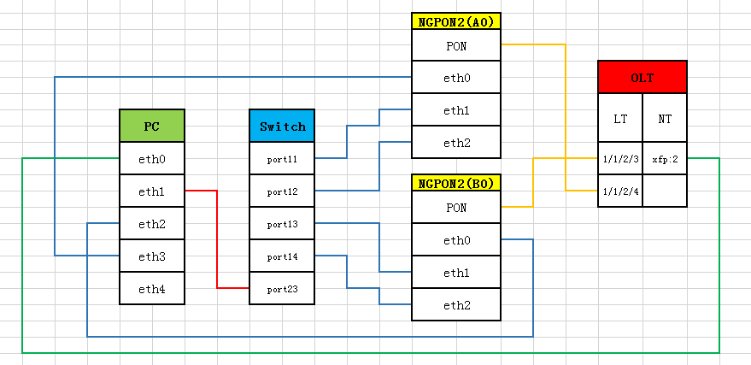
Topo
Jenkins Master
env1
env2
env3
env4
Env5
env6
env7
env8

Slide 9
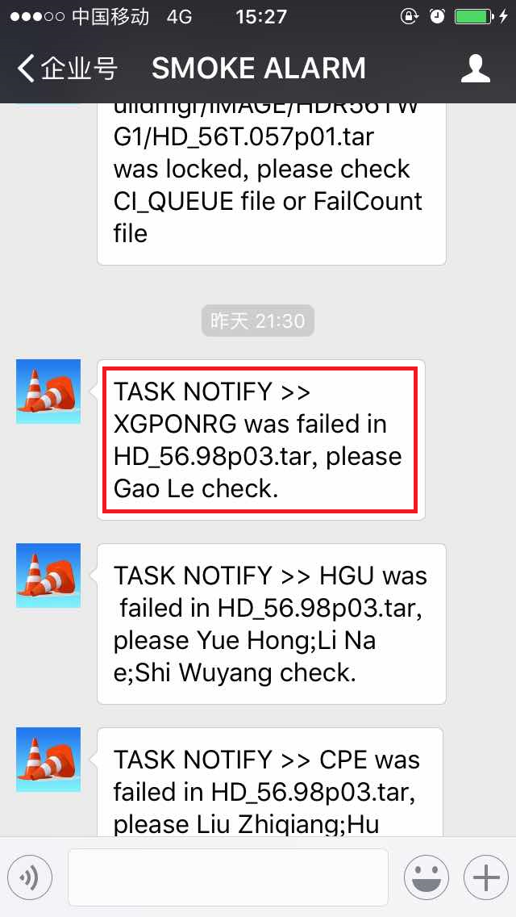
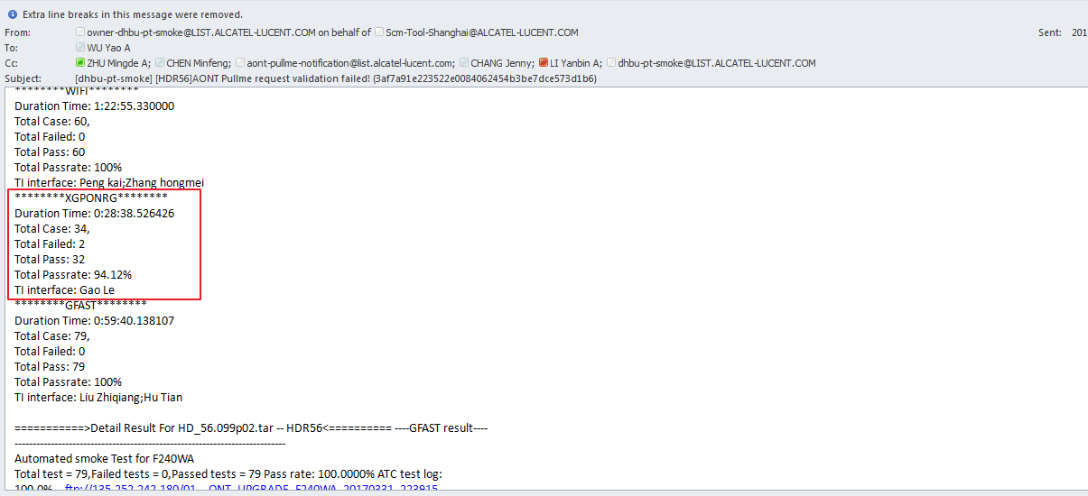
Two types of notification

Slide 10
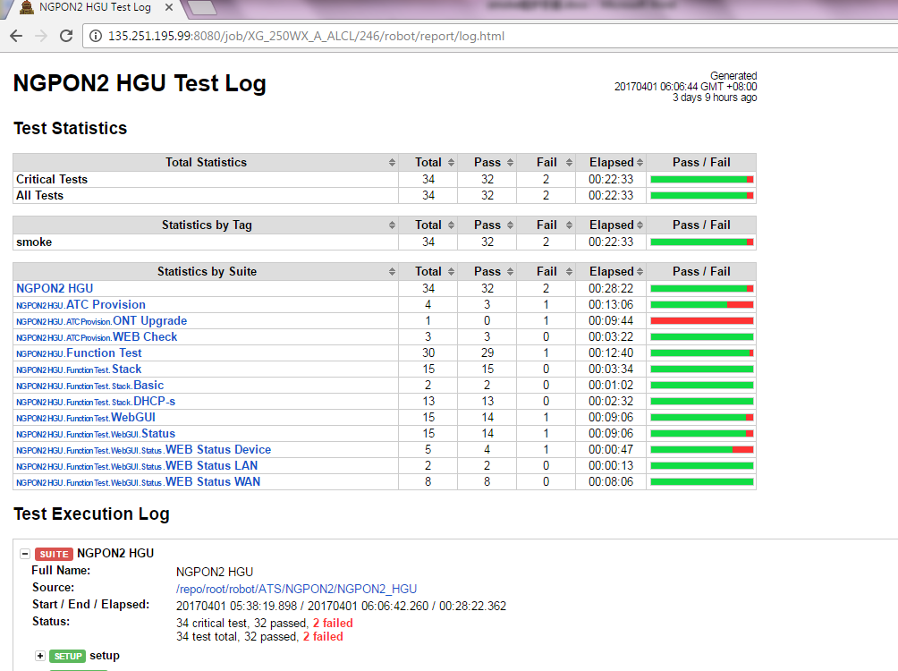
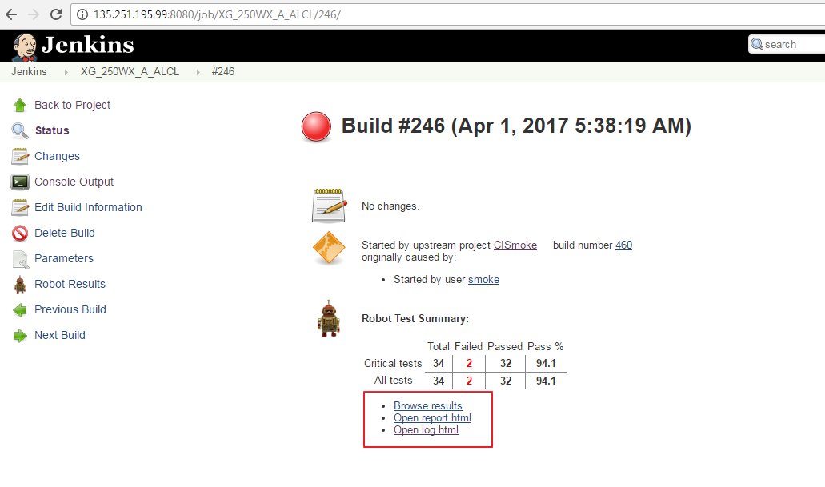
Analysis AT log

Slide 11
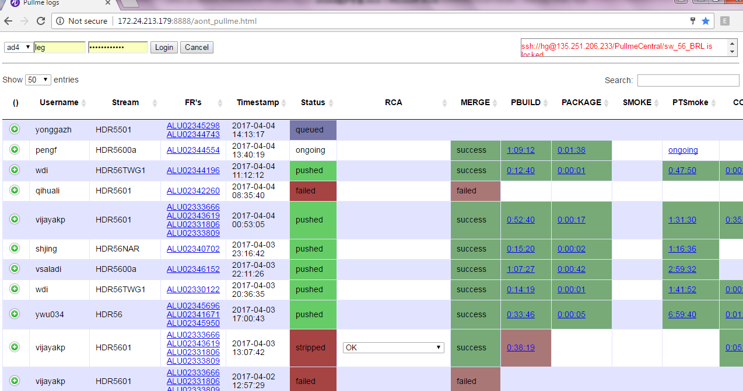
Enter the cause of failure
Environment or SW issue?
Legacy or new?
Notes: rerun
In order to avoid excessive fail due to
environmental problems, rerun mechanism
was introduced

Slide 13
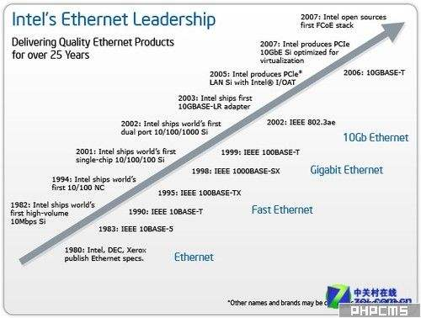
Ethernet’s history
20 century ‘ 70 s
Ethernet is a computer LAN technology.
The IEEE 802.3 standard is the technical standard for Ethernet,
which includes the content of the physical layer connection,
electronic signal and media access layer protocol.
Ethernet is the most widely used LAN technology,
displacing other LAN technologies

Slide 14
Comparison between Ethernet & CAN
CAN
1. data Link layer and the Physical layer
Ethernet
1. APP layer/ TCP IP layer
2. maximum transmission rate is 1Mbit/s
3. maximum length is 40 m
2. maximum transmission rate is 10000 Mbit/s
3. unlimited length

Slide 15
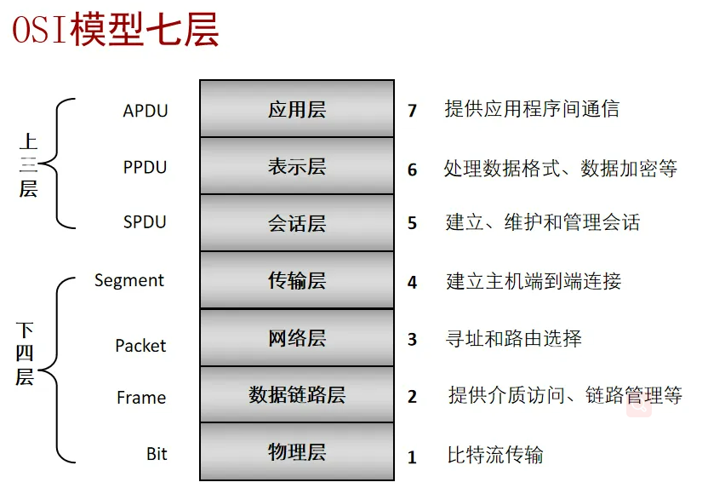
Seven-layer model of the network

Slide 16
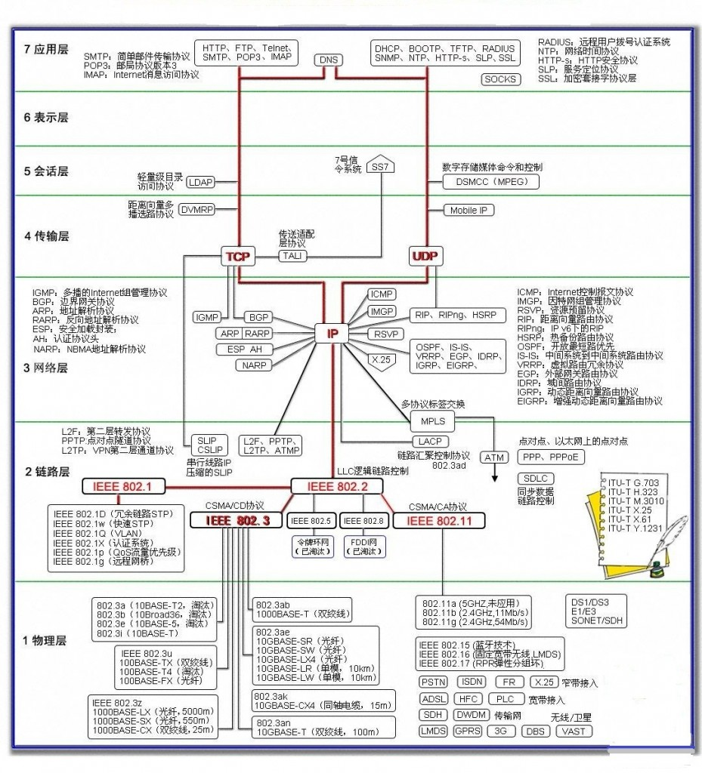
Seven-layer protocol

Slide 24
网络七层模型 五元组 can协议CAN协议仅包括数据链路层（介质访问控制子层MAC -Medium Access Control和逻辑链路控制子层LLC - Logical Link Control）和物理层（物理信号PLS - Physical Signaling）。 Can最大传输速率1Mbit/s，允许的最大长度是40米，CAN节点的最大数量也有限制。

Slide 25
Vlan的概念
单播 组播 广播
ARP, NDP, ICMP, IGMP, DHCP
TCP UDP
V4 v6

